Slide 1
Lecture 1
What is a Stochastic Process?

Slide 2
Stochastic Process
“System that evolves randomly in time”
Examples:
Stock Market
Queue at Qdoba
Inventory in a warehouse

Slide 3
Deterministic vs Probabilistic vs Stochastic
Deterministic Process:
Future state of the system and path is known
Probabilistic Process:
At a given time, the system state is uncertain
Stochastic Process:
System state changes randomly in time

Slide 4
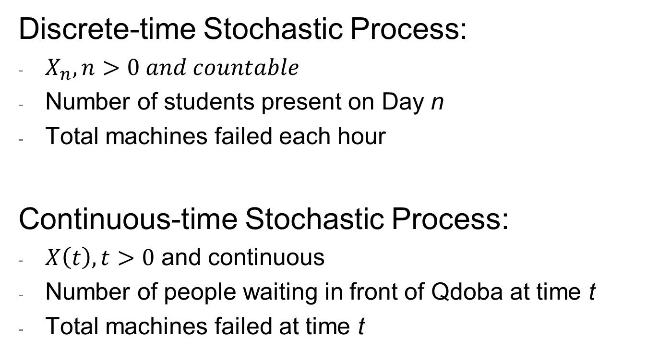
Types of Stochastic Processes
Discrete-time Stochastic Process:
$X_{n}, n>0 and countable$
Number of students present on Day n
Total machines failed each hour
Continuous-time Stochastic Process:
$X\left(t\right), t>0$ and continuous
Number of people waiting in front of Qdoba at time t
Total machines failed at time t

Slide 5
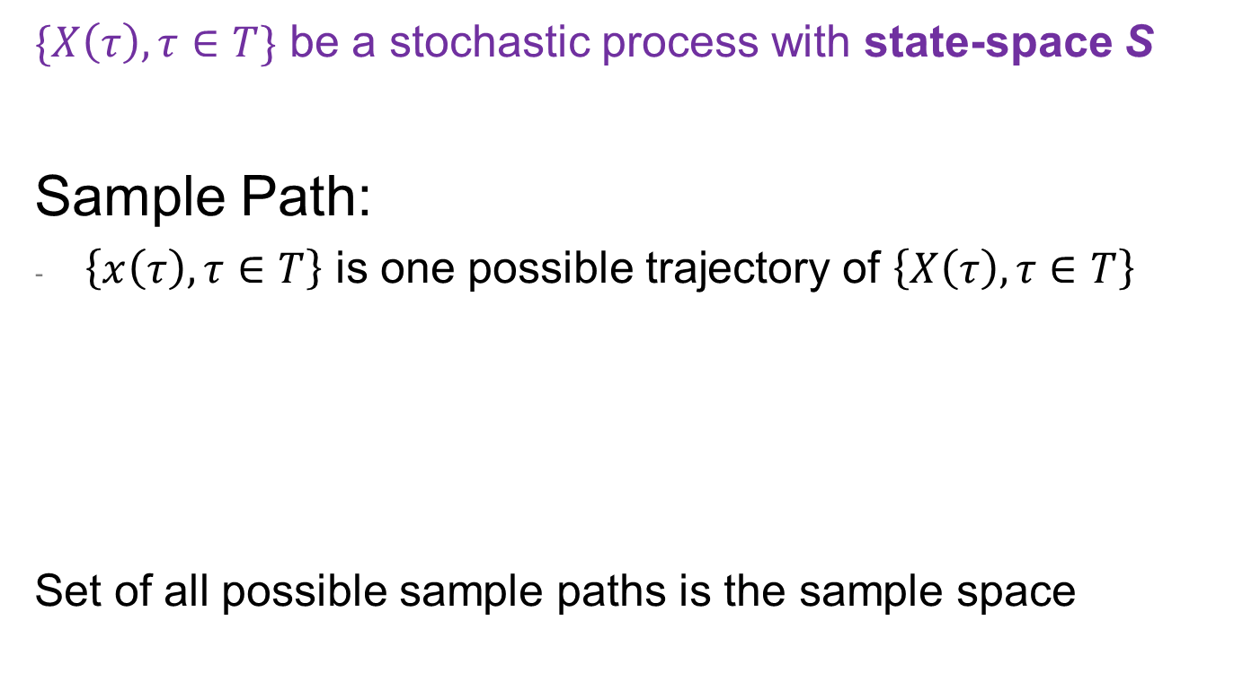
Sample Path and Sample Space
$\{X\left(τ\right), τ∈T\}$ be a stochastic process with state-space S
Sample Path:
$\left\{x\left(τ\right), τ∈T\right\}$ is one possible trajectory of $\left\{X\left(τ\right), τ∈T\right\}$
Set of all possible sample paths is the sample space
# people waiting
# people waiting
t
t

Slide 6
More Examples
Queues
Manufacturing
Reliability
Supply Chain
Quality Control
Finance

Slide 7
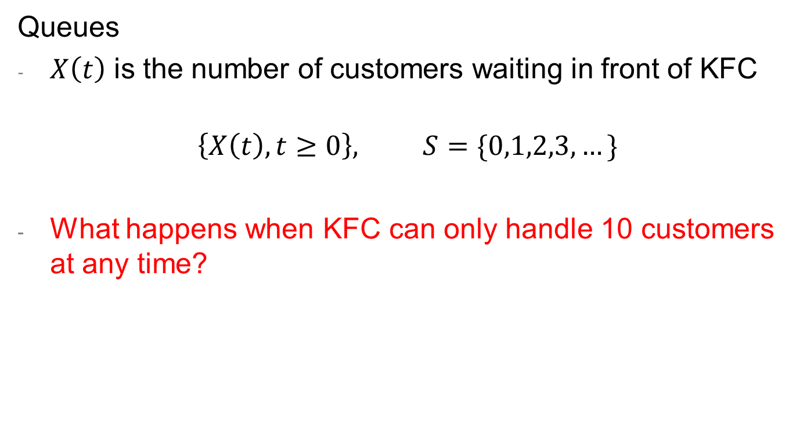
Discussion on Examples
Queues
$X\left(t\right)$ is the number of customers waiting in front of KFC
$$\left\{X\left(t\right), t≥0\right\}, S=\{0,1,2,3,…\}$$
What happens when KFC can only handle 10 customers at any time?

Slide 8
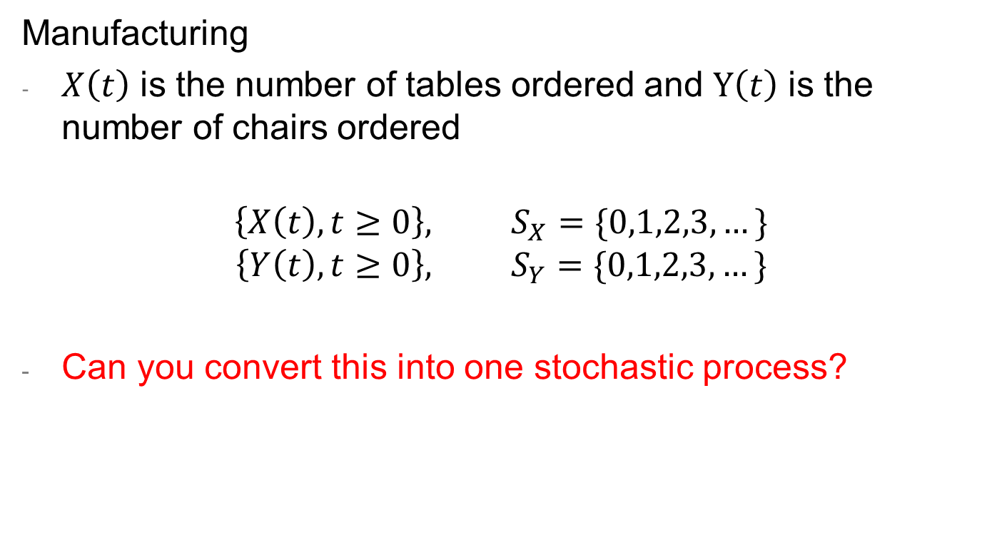
Discussion on Examples
Manufacturing
$X\left(t\right)$ is the number of tables ordered and $Y\left(t\right)$ is the number of chairs ordered
$$\left\{X\left(t\right), t≥0\right\}, S_{X}=\{0,1,2,3,…\}$$
$$\left\{Y\left(t\right), t≥0\right\}, S_{Y}=\{0,1,2,3,…\}$$
Can you convert this into one stochastic process?

Slide 9
Discussion on Examples
Supply Chain
A part can be made in-house or by subcontractor, demand and production times are random
Can you stochastic processes in such system?

Slide 10
Discussion on Examples
Reliability
Give me one discrete-time stochastic process related to reliability?
Give me one continuous-time stochastic process related to reliability?

Slide 11
What else will we learn?
Steady state vs transient behavior
Cost and reward
More examples to come!!
Other topics: random number generation, renewal process

